Slide 1

Fundamentals of Cybersecurity
Presented by
Dhrish

Slide 2
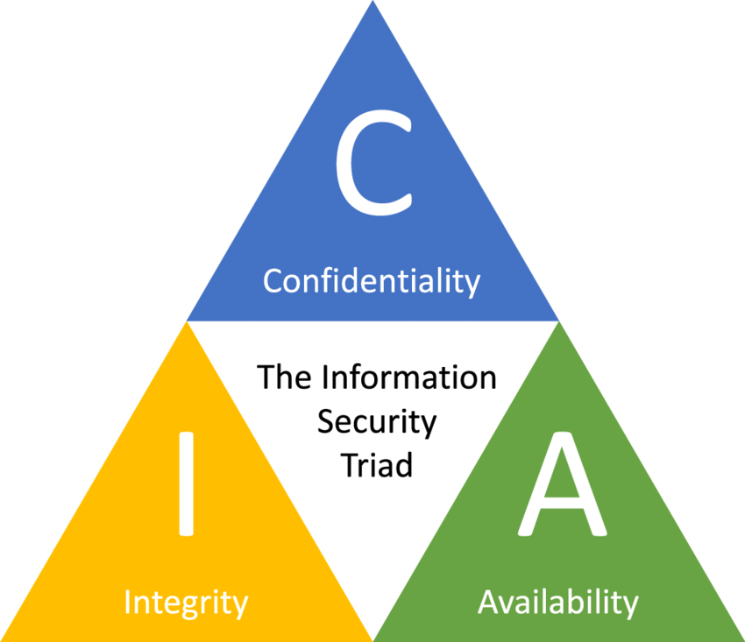
Cyber security Fundamentals
An organization or an individual can develop a proper response plan only when he has a good grip on cyber security fundamentals.
Confidentiality
Integrity
Availability

Slide 3
Confidentiality
Confidentiality is about preventing the disclosure of data to unauthorized parties.
It also means trying to keep the identity of authorized parties involved in sharing and holding data private and anonymous.
Often confidentiality is compromised by cracking poorly encrypted data, Man-in-the-middle (MITM) attacks, disclosing sensitive data.
Standard measures to establish confidentiality include:
Data encryption
Two-factor authentication
Biometric verification
Security tokens

Slide 4
Integrity
Integrity refers to protecting information from being modified by unauthorized parties.
Standard measures to guarantee integrity include:
Cryptographic checksums
Using file permissions
Uninterrupted power supplies
Data backups

Slide 5
Availability
Availability is making sure that authorized parties are able to access the information when needed.
Standard measures to guarantee availability include:
Backing up data to external drives
Implementing firewalls
Having backup power supplies
Data redundancy

Slide 6
The 7 Layers of Cyber Security

Slide 7
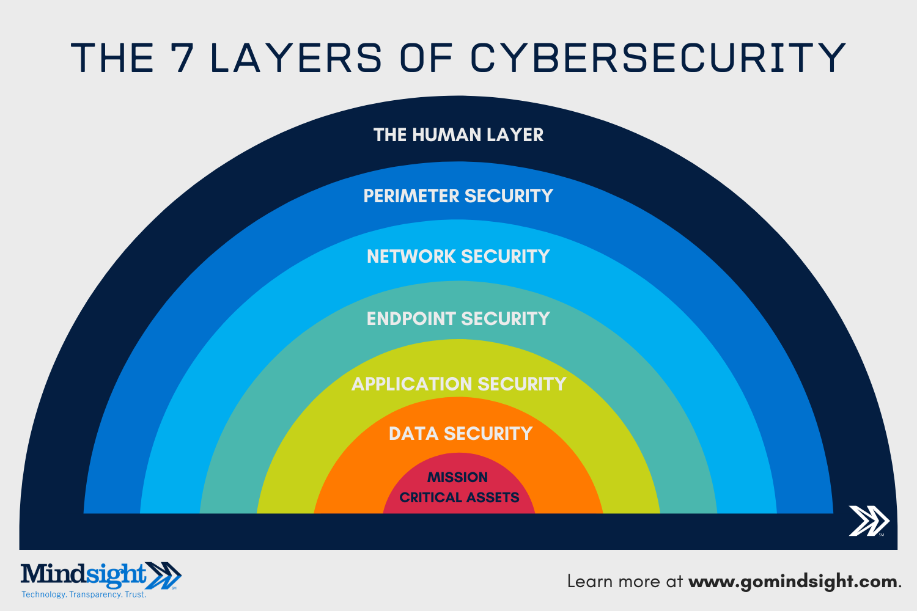
The 7 Layers of Cyber Security

Slide 8
The 7 Layers of Cyber Security
1: Mission Critical Assets – This is the data you need to protect
2: Data Security – Data security controls protect the storage and transfer of data.
3: Application Security – Applications security controls protect access to an application, an application’s access to your mission critical assets, and the internal security of the application.

Slide 9
The 7 Layers of Cyber Security
4: Endpoint Security – Endpoint security controls protect the connection between devices and the network.
5: Network Security – Network security controls protect an organization’s network and prevent unauthorized access of the network.
6: Perimeter Security – Perimeter security controls include both the physical and digital security methodologies that protect the business overall.

Slide 10
The 7 Layers of Cyber Security
7: The Human Layer – Humans are the weakest link in any cyber security posture. Human security controls include phishing simulations and access management controls that protect mission critical assets from a wide variety of human threats, including cyber criminals, malicious insiders, and negligent users.

Slide 11
Thank You

